Slide 1
COMPREHENSIVE DIGITAL MARKETING
FOR WIPRO ( Short term)
PROJECT WORK
Team details
Team lead : B . BAVYA NANDINI LAKSHMI
Team members : MYLIPILLI HARIKA
TANGULA DIVYA TEJ
MD AASHIQ UR RAHAMAN
BALA MURALI KRISHNA

Slide 2

Part – 1: Brand study , Competitor Analaysis & Buyer’s / Audience’s persona
Brand Logo :
COMPANY / TOPIC OF THE PROJECT :
BRAND LOGO :
wipro
wipro

Slide 3
Mission /values:
“Be a globally respected corporation that provides best-in-class products, solutions and services, and to be the most trusted partner for its stakeholders."
USP :
Wipro provides complete range of IT services to the organization
BRAND TONE AND IDENTITY:
Ambitions Realized encapsulates the bold innovation, expertise, and orchestration required to transform businesses for growth, develop the talent for the future, and create a sustainable planet for all.

Slide 4
5 SMART goals and KPI’s :
Setting specific, measurable, achievable, relevant, and time-bound (SMART) objectives is a good way to plan the steps to meet the long-term goals in your grant. It helps you take your grant from ideas to action.
Key performance indicators are
Revenue growth.
Revenue per client.
Profit margin.
Client retention rate.
Customer satisfaction

Slide 5
Buyer’s / Audience’s Persona
Demographics persona :
Wipro limited has 231,671 employees.
35% of wipro limited employees are women,
while 65% of wipro limited employees are men.
The most common ethnicity at wipro limited is white (38%).
38% of wipro limited employees are asian.
Pyschographic persona :
- Are you connected with the right individual ?
Yes, we are connected with the right people by their past purchase history and with the help of our social media handles by their search history.

Slide 6
- what social media channels our customer are using ?
As the world is becoming fully digital, each and everyone is having all social media accounts to socialize and follow updates in the world. ( Instagram, facebook, twitter, youtube, threads, etc...).
- What social media channel do they use the most ?
Most of our targeted customers are consuming most of their time in Instagram and Facebook. So marketing in these platforms makes us reach more customers.
- How do they get the information about our products ?
Customers get the information about our products through television ads and social media ads.

Slide 7
Behaviour and Interests:
Being Respectful, Being Responsive, Always Communicating, Demonstrating Stewardship and Building Trust.
Wipro PARI has built one of the world's industry leading talent pools to support our customer's toughest challenges. Our company's knowledge and knowhow are supported with industry leading systems in project management, reusable engineering products & modules, learning systems, products & processes.

Slide 8

Competitor analysis:
Competitor 1: INFOSYS
Website: https://www.infosys.com
USP :
To achieve our objectives in an environment of fairness,honesty and courtesy towards our clients,employees ,vendors and society at large

Slide 9

Competitor 2 : CAPGEMINI
Website : | www.capgemini.com
USP:
A global leader in consulting, technology services and digital transformation, Capgemini is at the forefront of innovation to address the entire breadth of clients' opportunities in the evolving world of cloud, digital and platforms

Slide 10

Competitor 3 : TATA CONCULTANCY SERVICES ( TCS)
WEBSITE :
https://www.tata.com/business/tcs
Its consulting-led, cognitive powered, portfolio of business, technology and engineering services and solutions is delivered through its unique Location Independent AgileTM delivery model, recognized as a benchmark of excellence in software development.
USP :

Slide 11
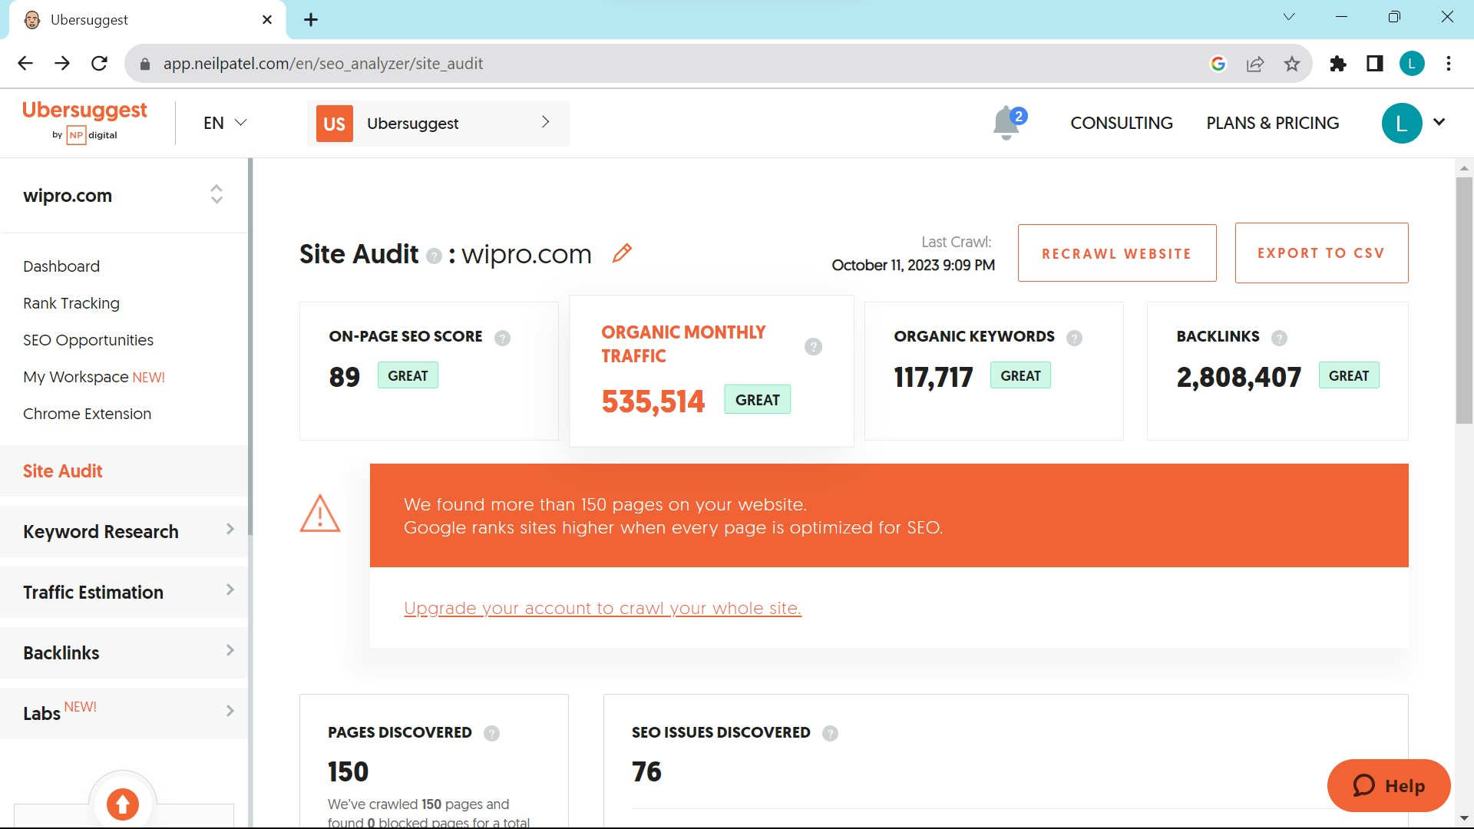
PART 2: SEO & KEYWORD RESEARCH
SEO Audit :

Slide 12
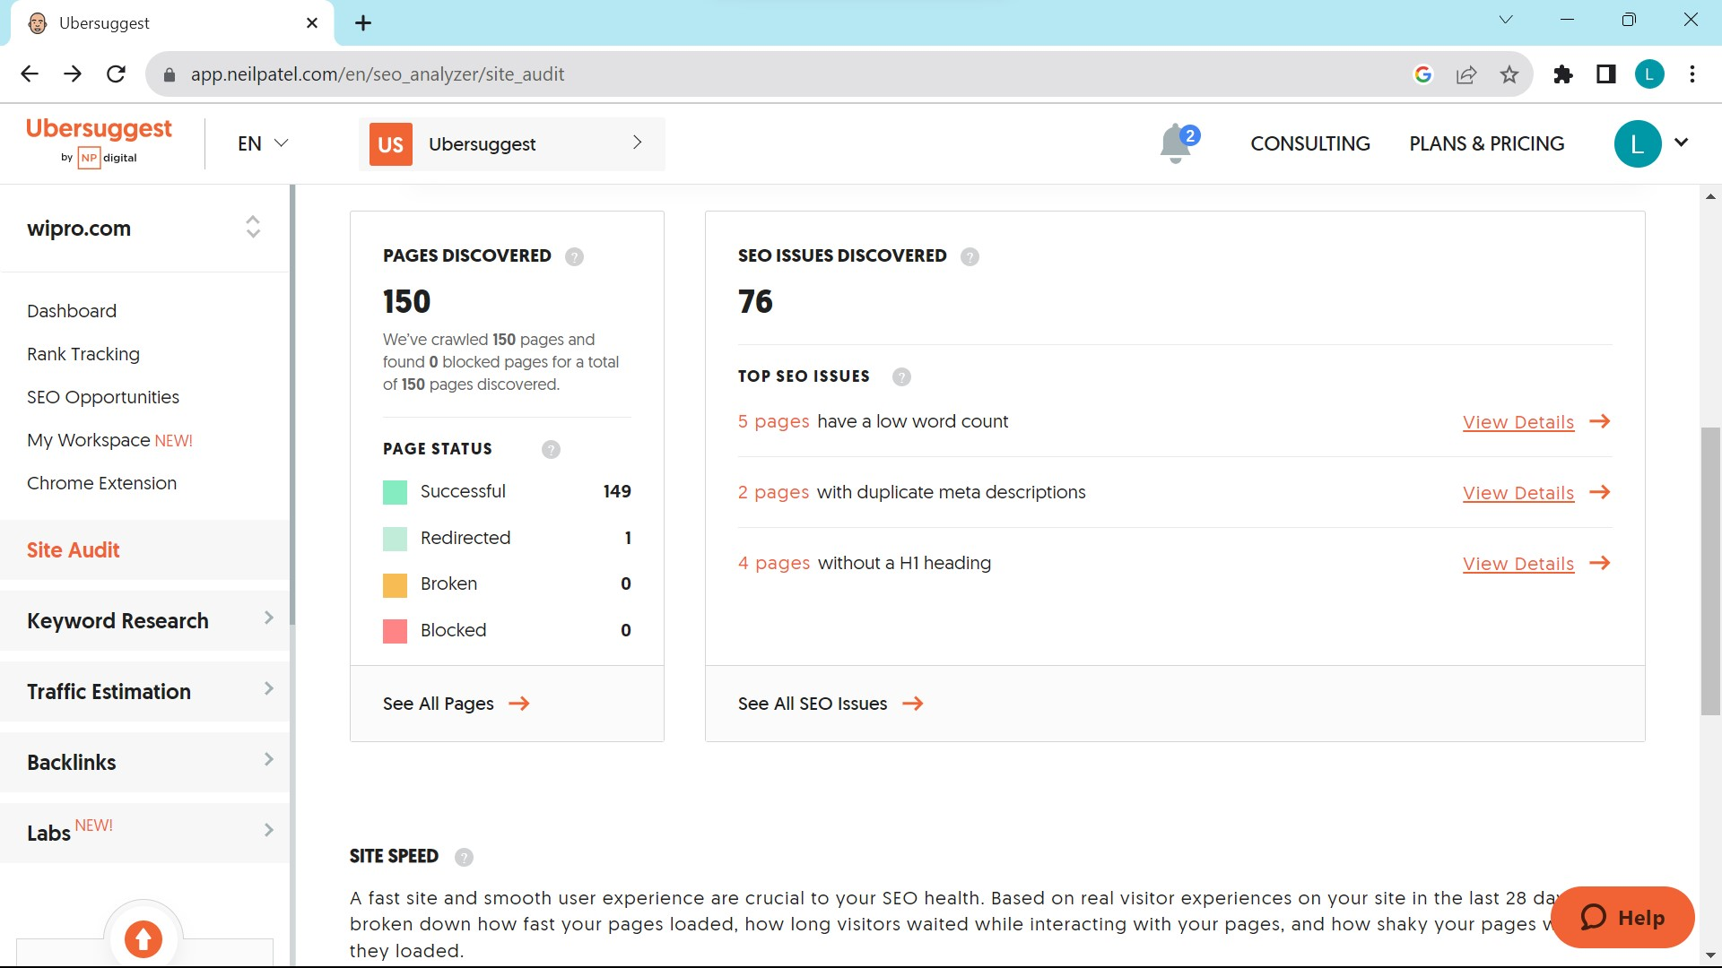

Slide 13
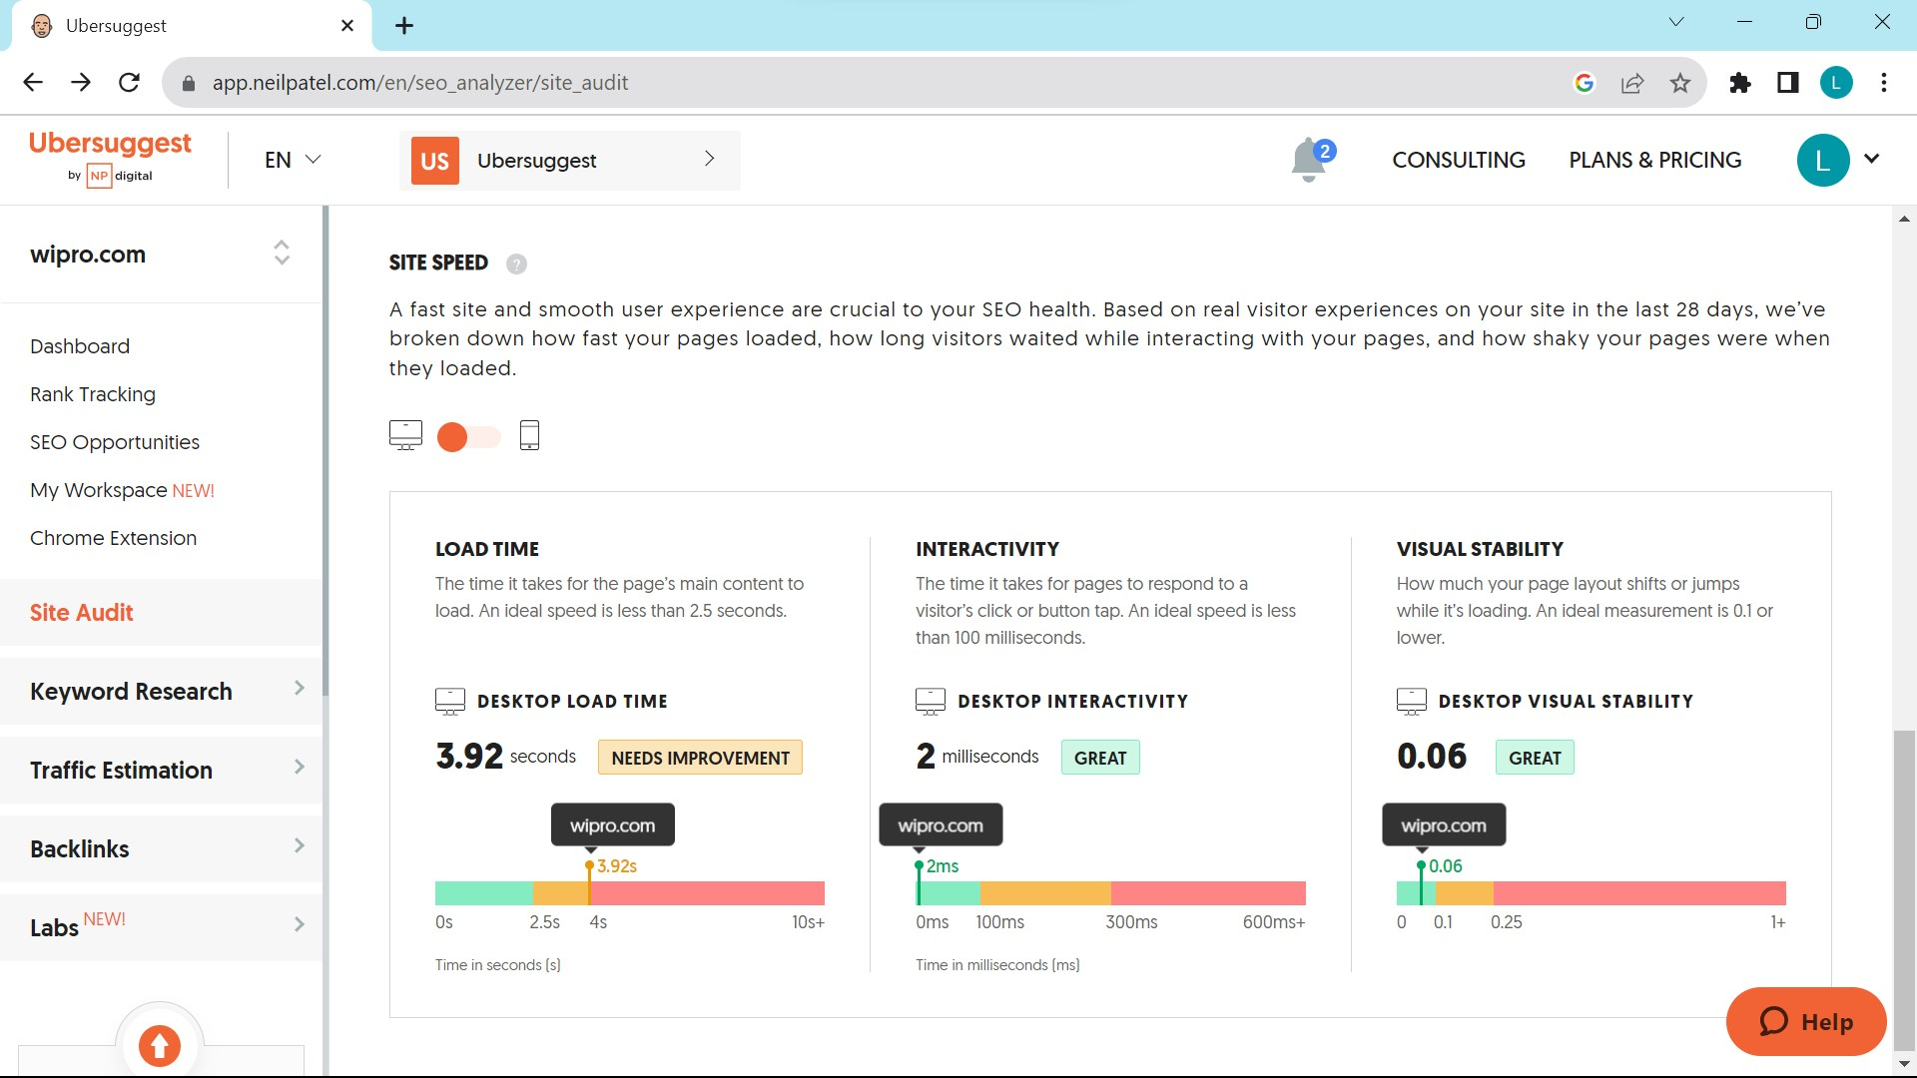

Slide 14
Keyword search :
OBJECTIVES FOR KEYWORD RESEARCH:
TO INCREASE WEBSITE TRAFFIC:
As keyword research helps us know which key words are used by target customer mostly, by this we can improve our website traffic.
TO IMPROVE ORGANIC SEARCH RANKING:
By keyword research we can know which key words are performing best, which high search volume and lower competition, so that we can optimize our website with those key words to improve organic search ranking.
TO REACH OUT MORE AUDIENCE:
Keyword research helps us find out which keys are god to target out prospective customers and so that we can use those keywords in our website’s content.

Slide 15
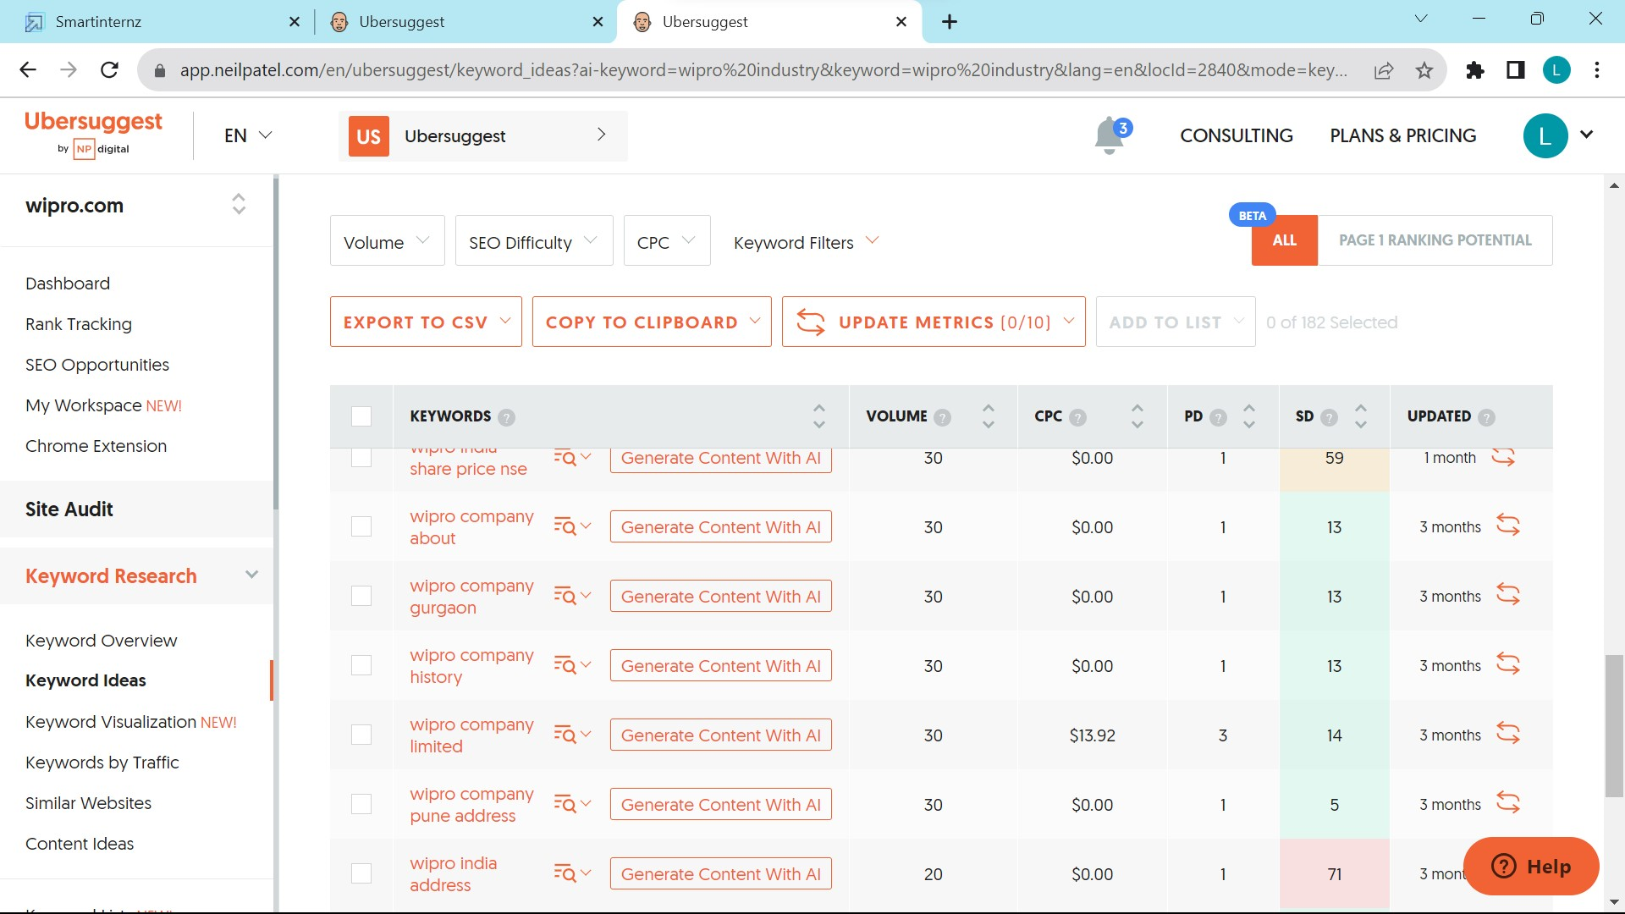
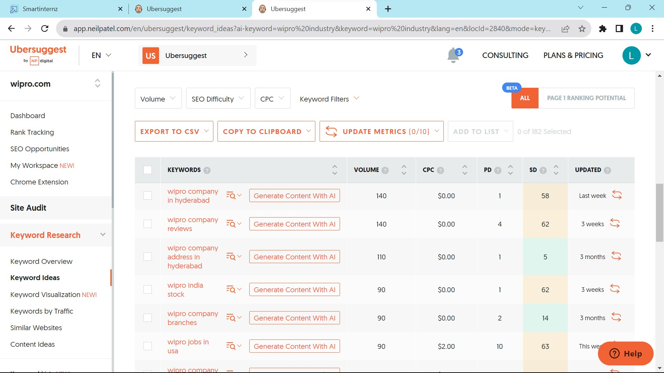

Slide 16
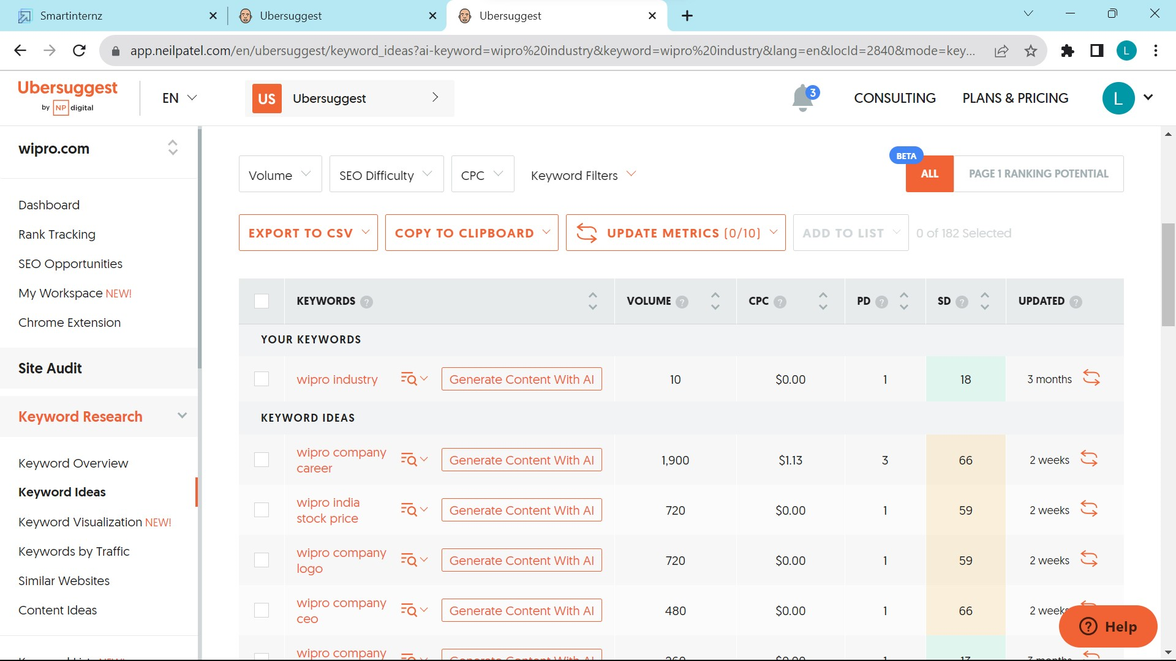

Slide 17
Long-tail keywords for "Wipro" could include:
"Wipro IT services and consulting“
2. "Wipro stock price analysis 2023“
3. "Wipro digital transformation solutions“
4. "Wipro campus recruitment process“
5. "Wipro sustainability initiatives“
6. "Wipro healthcare technology solutions“
7. "Wipro cloud computing services“
8. "Wipro customer case studies“
9. "Wipro AI and machine learning projects“
10. "Wipro cybersecurity services and trends"

Slide 18
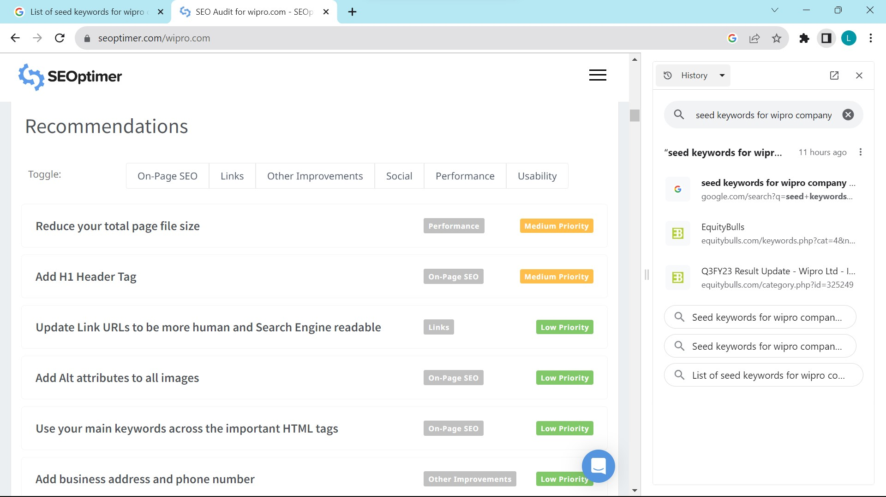
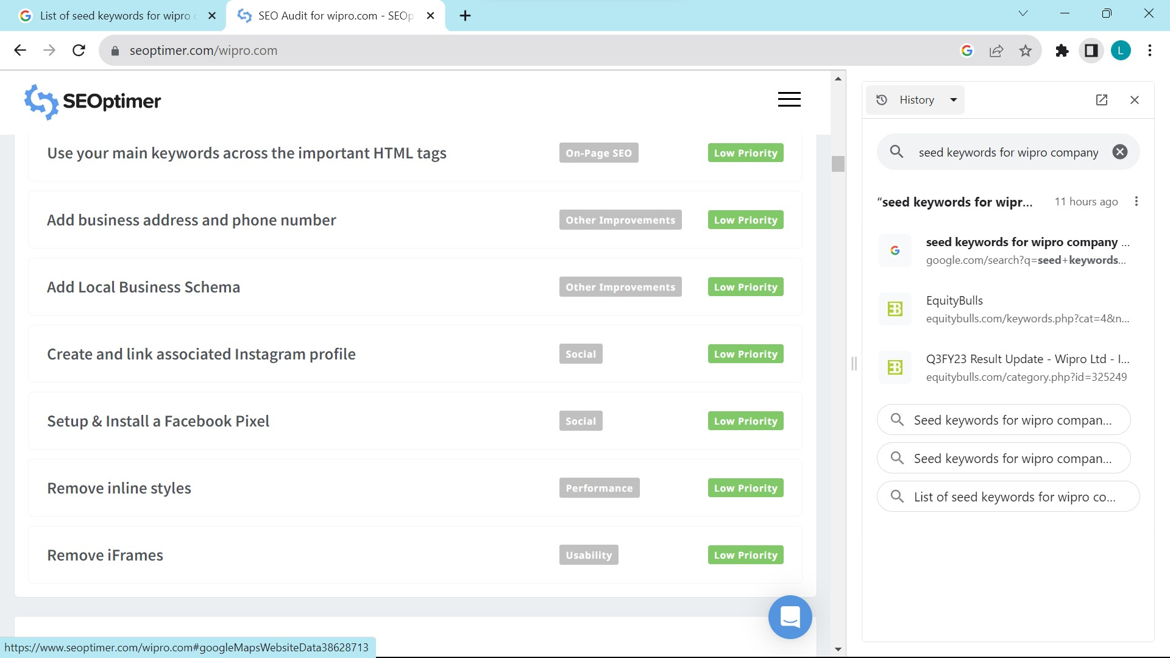

Slide 19
ON PAGE OPTIMIZATION :
META TITLE’S :
Meta titles for Wipro's website or webpages might include:
1."Wipro - Transforming Businesses with Technology Solutions
"2. "Wipro - Global IT Consulting and Services Company“
3. "Explore Wipro's Expertise in IT Services and Consulting“
4. "Wipro: Innovating for a Sustainable Future“
5. "Wipro Careers: Join Our Team of Tech Professionals“
6. "Wipro News and Updates - Stay Informed“
7. "Wipro's Digital Transformation Services“
8. "Wipro's Industry-Leading Cloud Solutions“
9. "Wipro's Commitment to Cybersecurity“
10. "Contact Wipro for Business Solutions“

Slide 20
META DESCRIPTION :
Meta descriptions for Wipro's webpages could be as follows:
"Discover how Wipro leverages technology to drive business innovation and growth. Explore our IT consulting and services.
"2. "Wipro is a global leader in IT solutions. Learn more about our expertise and how we can help your organization succeed.“
3. "Wipro's sustainable practices and initiatives for a greener, better future. Explore our commitment to environmental responsibility.“
4. "Start your career with Wipro - a place for tech enthusiasts. Find exciting opportunities to join our team.“
5. "Stay updated with the latest news and developments from Wipro. Your source for industry insights and company updates.
"6. "Wipro's digital transformation services empower businesses to thrive in the digital age. Discover our solutions.“
7. "Experience the power of the cloud with Wipro's cutting-edge cloud computing solutions. Explore our offerings.“
8. "Wipro is your trusted partner in cybersecurity. Learn about our robust security solutions and practices.“
9. "Connect with Wipro for tailored business solutions and IT services. Let us help you succeed in a rapidly changing world."

Slide 21
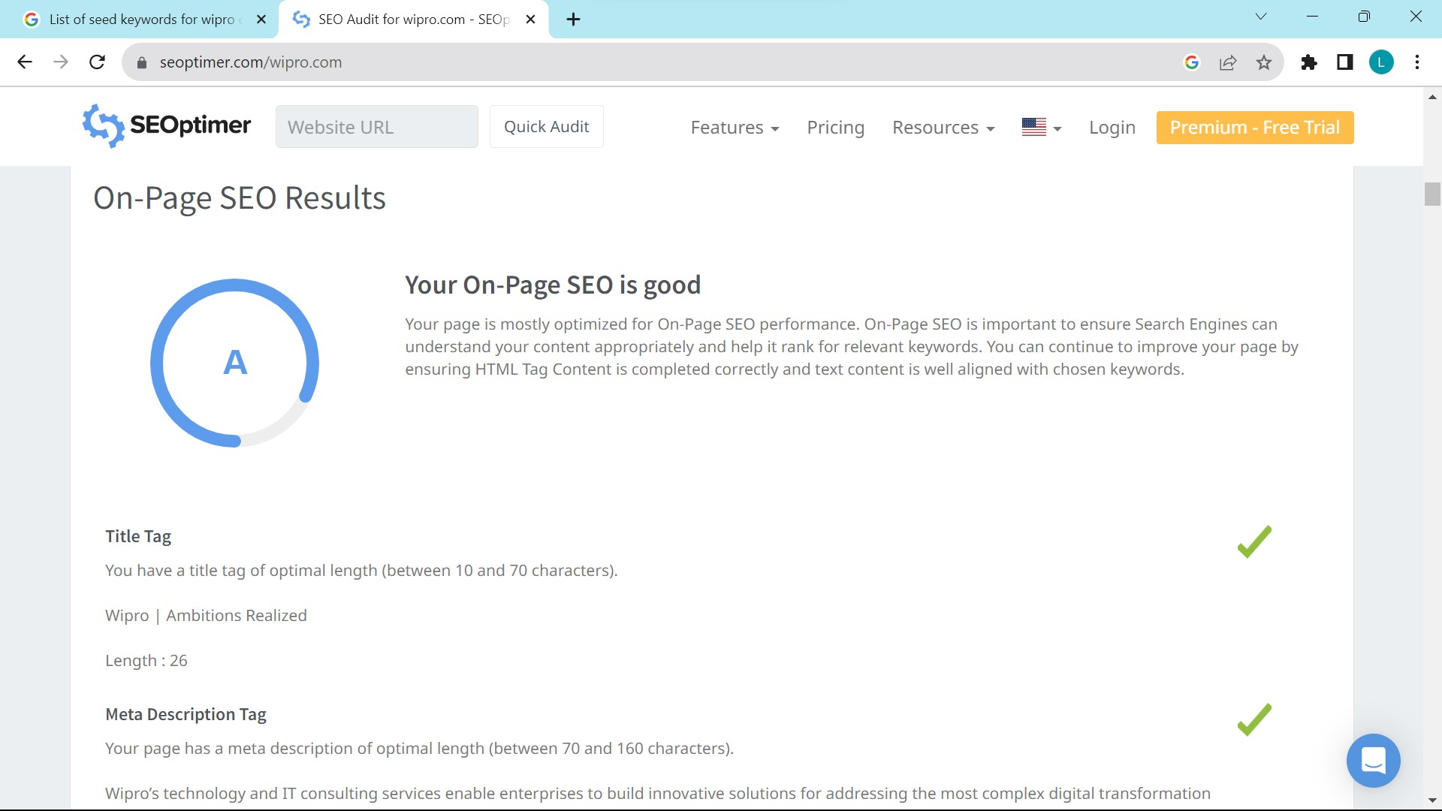
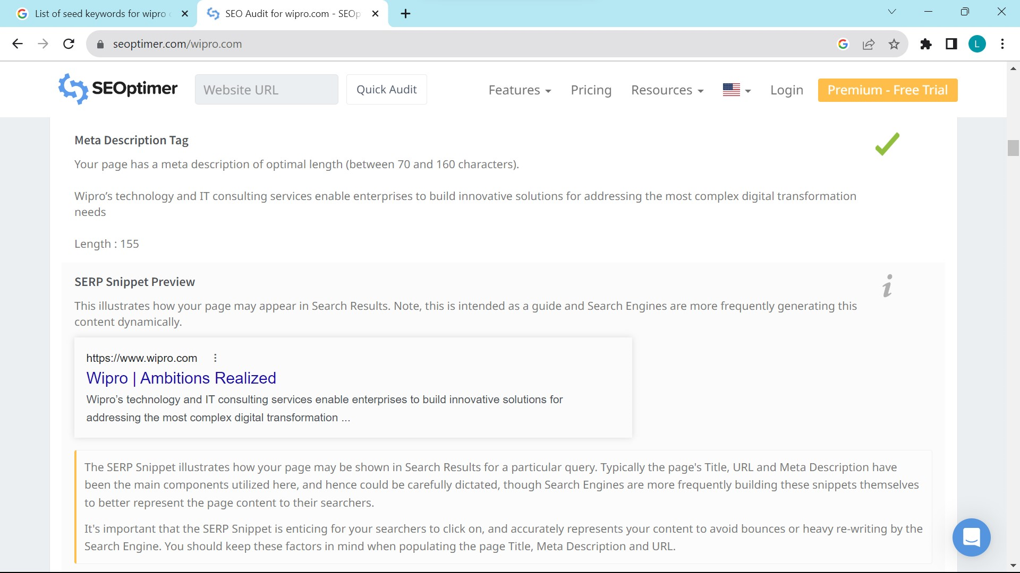

Slide 22
PROCESS OF CONDUCTING KEYWORD RESEARCH :
1 .Understand your goals: Begin by defining the purpose of your keyword research. Determine whether you want to Increase your website’s traffic or the other things.
2. Asses initial ideas: Start by brainstorming a list of keywords relevant to your business. Think about what keys your target audience might use when searching for information related to your industry.
3. Use keyword research tools : Utilize keyword research tools such as Google Keyword Planner, SEMrush, or Moz Keyword Explorer. These tools provide valuable insights into search volume, competition, and related keywords.
4. Analyze search intent: Consider the intent behind each keyword. Are users searching with the intent to make a purchase? Understanding search intent helps you align your content with user expectations.
5. Assess competition: Evaluate the competitiveness of each keyword. Look for keywords with a good balance of search volume and manageable competition.
6. Refine your keyword list: Decrease down your keyword list by selecting the most relevant and promising keywords. Focus on those with a good search volume and relatively lower competition.
7. Consider user relevance: Ensure that the selected keywords align with your target audience's interests, needs, and search preferences. Think about how users would search for your content or offerings and choose keywords accordingly.

Slide 23
CHALLENGES FACED DURING KEYWORD RESEARCH AND ANALYSIS:
1.Limited data accuracy: Keyword research tools provide estimates and data based on historical trends. It's essential to consider this potential limitation when conducting keyword analysis.
2. Highly competitive keywords: Some keywords may have high search volume but also intense competition. Ranking for such keywords can be challenging, especially if your website or content is relatively new.
3. Shifting search trends: Search trends and user behavior change over . Staying up-to-date with the latest trends and adjusting your keyword strategy accordingly is crucial.
4. Lack of user intent understanding: Merely identifying keywords without considering user intent can lead to suboptimal results. It's important to understand the intent behind a keyword search to provide the most relevant content and capture the right audience.
5. Multilingual keyword research: If you are targeting a multilingual or international audience, conducting keyword research in multiple languages can pose an additional challenge. Language differences, cultural differences, and varying search behaviors need to be considered for effective keyword analysis.

Slide 24
KEY INSIGHTS:
1.Increased organic traffic: By targeting relevant keywords with a good search volume and low competition, you can improve your website's visibility in search engine results.
2. Improved search engine rankings: This can lead to improved visibility, credibility, and more organic traffic.
3. Targeted content creation: Keyword research helps identify the topics and questions that your target audience is searching for. By incorporating these keywords into your content strategy, you can create valuable, relevant content that meets the needs of your audience.
4. Enhanced user experience: Understanding user search intent through keyword research allows you to align your content with what users are looking for. This improves the overall user experience on your website, leading to increased engagement, longer visit durations, and lower bounce rates.
5. Competitive advantage: By focusing on these untapped keywords, you can gain a competitive advantage and attract targeted traffic that your competitors are missing out on.

Slide 25
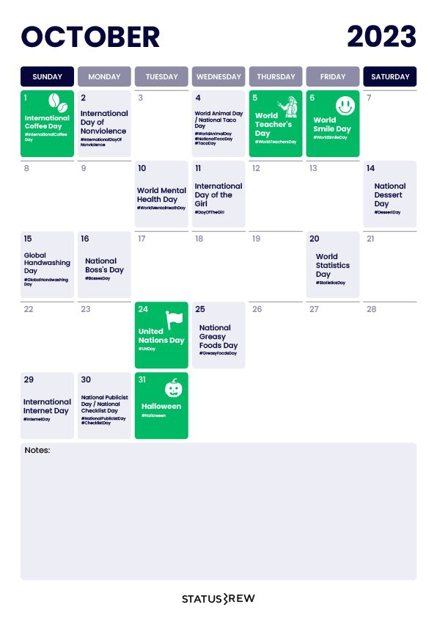

PART 3 CONTENT CREATION AND MARKETING STRATEGIES
Content Idea Generation & Strategy:
Content calendar of wipro

Slide 26
STRATEGY, AIM, IDEA BEHIND THE CONTENT
1. BLOG POST:
Date of publish :
Topic :
Aim:
Stategy:
12 / 10/ 2023
Winning gold at mega corporate film festival award
With awards galore, Wipro is one of the most recognized companies in the IT space.
Our longstanding reputation is poised to continue with strong growth in the future. We have received innumerable corporate awards that speak for the innovations introduced by us and the various milestones achieved.
2 . REEL/VIDEO POST
Date of publish :
Topic :
Aim:
Stategy:
12 / 10/ 2023
From start up to global IT gaint
Global Expansion (2000s-Present): Wipro aimed to expand globally, with a focus on IT consulting, business process outsourcing, and R&D services. Their aim was to become a global IT giant, serving clients worldwide and diversifying into various industry sectors.
Strategic Acquisitions: Wipro strategically acquired other companies in the IT sector to strengthen their portfolio and expertise. These acquisitions helped them gain a competitive edge.

Slide 27
3. Creative / meme :
Date of publish :
Topic : saving job in wipro company
Aim:
Stategy:Problem-Solving Skills: Develop strong problem-solving skills to address challenges and find innovative solutions.
Continuous Learning: Stay updated with industry trends and technologies. Invest in ongoing learning and skills development to remain valuable to the company.
4 . INSTAGRAM STORIES:
Date of publish :
Topic :
Aim:
Stategy:
12 / 10/ 2023
Selection of jobs
Career Growth: To advance your career, gain new skills, and take on greater responsibilities within a well-established and respected IT company.
Self-Assessment: Understand your skills, strengths, weaknesses, and career goals. Consider what type of role, industry, and location are the best fit for you.

Slide 28
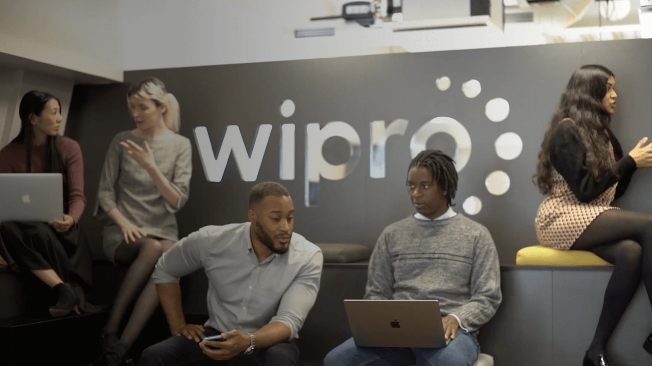
Part 4: Content Creation and Curation
Post Creation:
FORMAT 1 : BLOG POST
Title : “ A journey of innovation and excellence “
BRAND : WIPRO
COMPANY:
Indian multinational corporation
Wipro Ltd., the flagship company of the Azim H Premji group was incorporated in the year 1945. The company started off originally as a manufacturer of vegetable ghee/vanaspati, refined edible oils etc. Gradually the company has diversified into various other businesses.
Today Wipro Limited is the first PCMM Level 5 and SEI CMM Level 5 certified IT Services Company globally. Wipro provides comprehensive IT solutions and services, including systems integration, Information Systems outsourcing, package implementation, software application development and maintenance, and research and development services to corporations globally.
In the Indian market, Wipro is a leader in providing IT solutions and services for the corporate segment in India offering system integration, network integration, software solutions and IT services. Wipro also has profitable presence in niche market segments of consumer products and lighting. In the Asia Pacific and Middle East markets, Wipro provides IT solutions and services for global corporations.
Wipro's ADSs are listed on the New York Stock Exchange, and its equity shares are listed in India on the Stock Exchange – Mumbai, and the National Stock Exchange, among others.

Slide 29
Wipro is the leading strategic IT partner for companies across India, the Middle East and Asia–Pacific – offering integrated IT solutions. They plan, deploy, sustain and maintain your IT lifecycle through their total outsourcing, consulting services, business solutions and professional services. Wipro InfoTech helps you drive momentum in your organisation – no matter what domain you are in.
Backed by their strong quality processes and rich experience managing global clients across various business verticals, they align IT strategies to your business goals. Along with their best of breed technology partners, Wipro InfoTech also helps you with your hardware and IT infrastructure needs.
The various accreditations that they have achieved for every service they offer reflect their commitment towards quality assurance. Wipro InfoTech was the first global software company to achieve Level 5 SEI–CMM, the world's first IT Company to achieve Six Sigma, as well as the world's first company to attain Level 5 PCMM.
Their continuing success in executing projects is a result of their stringent implementation of quality processes. Deploying quality frameworks to align with your business will give you the benefit of a smooth and transparent transition while providing complete IT lifecycle management. Reliability and perfection are a result of their adherence to these quality benchmarks and this has been their key differentiator, while helping drive the business momentum.
The company’s experience and expertise are measured against globally recognized standards to ensure their commitment in delivering competitive solutions to their customers. Wipro InfoTech epitomises quality by maintaining high standards in service offerings and products, as well as internal processes and people management. They believe in constantly scaling quality standards by expanding our efficiency in all areas beyond their basic IT offerings.

Slide 30
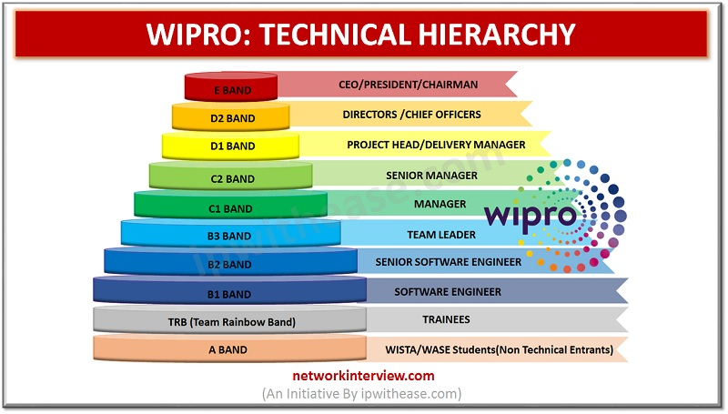
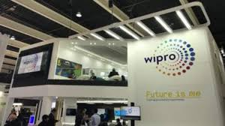
Wipro was having its presence across various verticals viz;(it decided to shut its hardware business in 2013)
Wipro Personal Computing Products
Enterprise Products
Software Products and Licences
Wipro Personal Computing Products:–
DesktopsEntry Level:
Wipro Desktop WSG37205
Wipro Desktop WSG37555
Wipro Desktop WSG15C55
Wipro Desktop WSG15D55
Wipro Desktop WSG41155.
Product and services offered by the company
Mainstream:
Wipro Desktop WSG53255
Wipro Desktop WSG37555
Wipro Desktop WSG15C55
Wipro Desktop WSG15D55
Wipro Desktop WSG41155.
Performance:
Wipro Desktop WSG38105
Wipro Desktop WSG41155

Slide 31
USD
11.3 BN
FY23 REVENUE
Wipro Limited (NYSE: WIT, BSE: 507685, NSE: WIPRO) is a leading technology services and consulting company focused on building innovative solutions that address clients’ most complex digital transformation needs.
OVER
1,400
ACTIVE GLOBAL CLIENTS
We leverage our holistic portfolio of capabilities in consulting, design, engineering, operations, and emerging technologies to help clients realize their boldest ambitions and build future-ready, sustainable businesses.
OVER
250,000
DEDICATED EMPLOYEES
A company recognized globally for its comprehensive portfolio of services, strong commitment to sustainability and good corporate citizenship, we have over 250,000 dedicated employees serving clients across 66 countries.
WE’RE PRESENT IN
66
COUNTRIES
We deliver on the promise of helping our customers, colleagues, and communities thrive in an ever-changing world.
A PROUD HISTORY OF OVER
75
YEARS

Slide 32
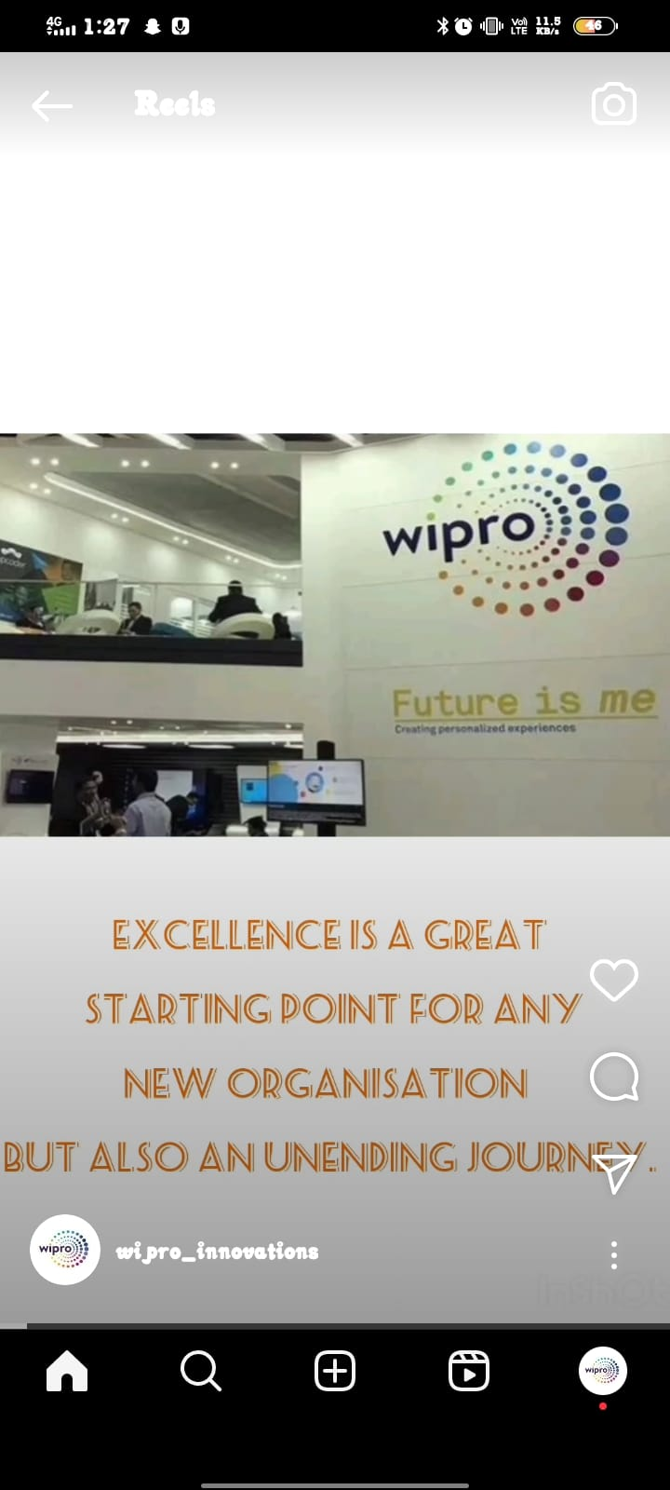
FORMAT 2 : REEL/ VIDEO POST
Title : wipro awareness
Caption : "Connecting ideas, technology, and the future. #WiproInnovates"
Hashtags : #wipro , #wiproinnovations , #Itwipro .
Posted date : 12/10/2023
Link :
https://www.instagram.com/reel/CySnnkcSCkf/?igshid=MmU2YjMzNjRlOQ==

Slide 33
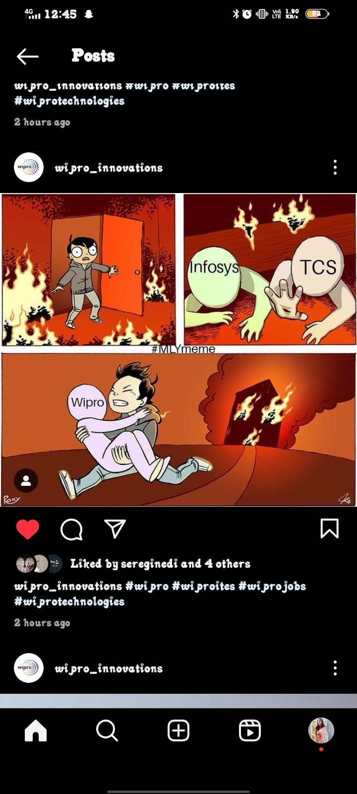
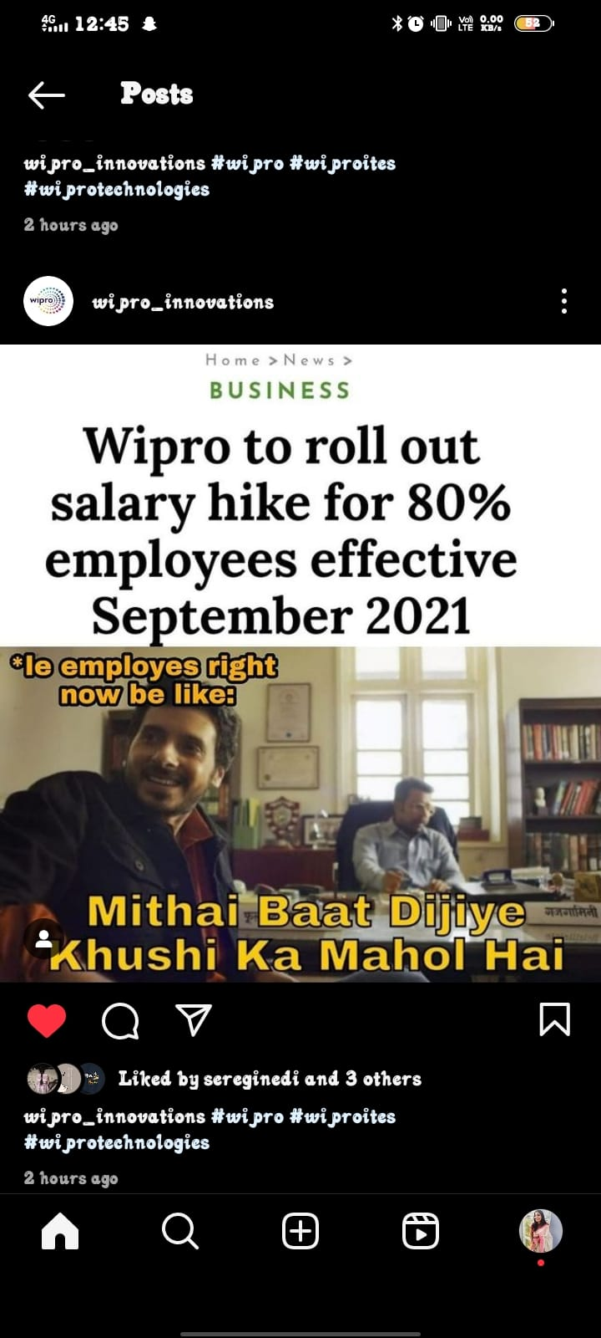
FORMAT 3 : CREATIVES / MEMES
https://www.instagram.com/p/CySUonqSW_E/?igshid=MzRlODBiNWFlZA==
https://www.instagram.com/p/CySUwdjyTIX/?igshid=MzRlODBiNWFlZA==

Slide 34
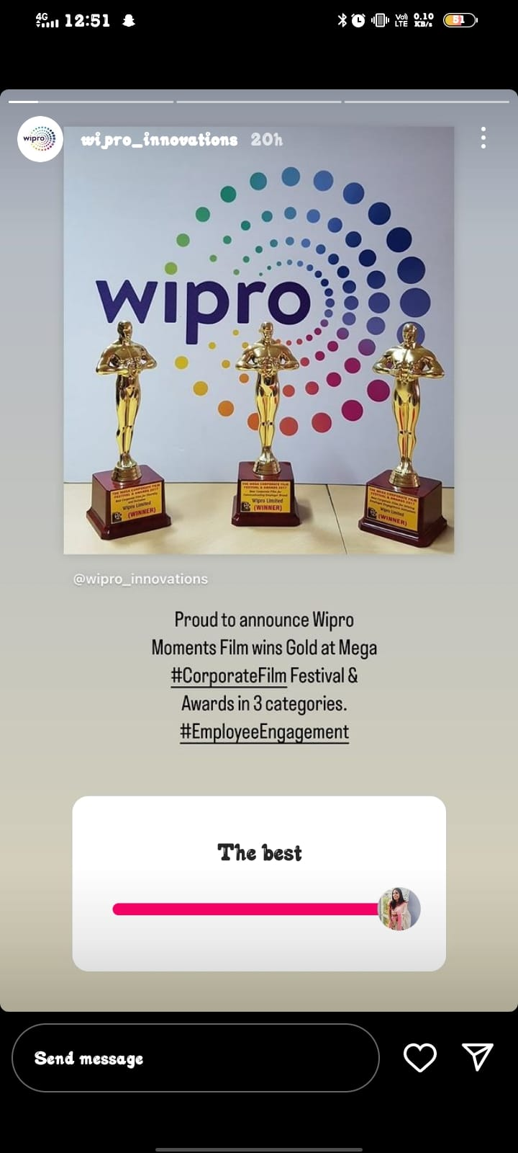
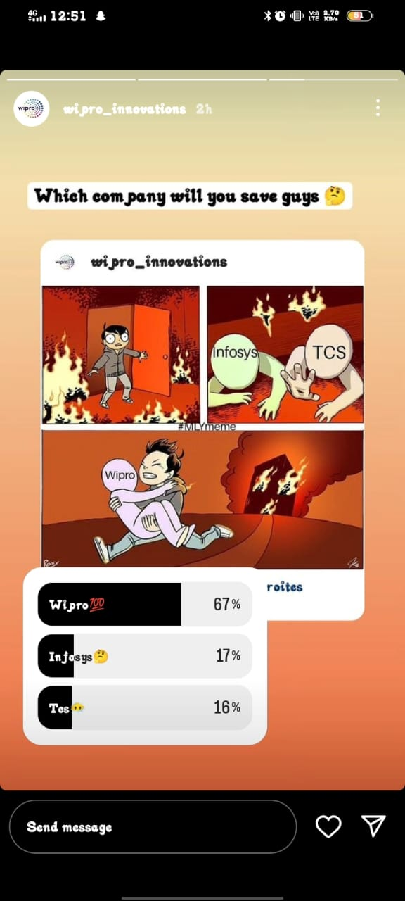
INSTAGRAM STORIES
https://instagram.com/stories/wipro_innovations/3211182912506990845?utm_source=ig_story_item_share&igshid=YTUzYTFiZDMwYg==
https://instagram.com/stories/wipro_innovations/3211724617966923337?utm_source=ig_story_item_share&igshid=YTUzYTFiZDMwYg==

Slide 35
Content creation and content process :
Define Goals and Objectives: Start by clearly defining the goals and objectives of your content creation. Determine what you want to achieve, whether it's increasing brand awareness, driving website traffic, generating leads, or fostering engagement. Having clear objectives will provide guidance throughout the process.
Identify Target Audience: Understand who your target audience is and what their interests, preferences, and needs are. Conduct market research to gather insights.
Content Ideation: Brainstorm ideas that align with your goals and target audience. Consider creating a content calendar to plan and organize your content in advance. Generate ideas based on trends, industry news, customer pain points, and popular topics.
Content Creation: Once you have solid ideas, it's time to create the content. This involves writing blog posts, designing visuals, or developing any other relevant formats. Pay attention to quality and ensure that the content is well-researched, informative, engaging, and aligns with your brand voice and values.
Content Optimization: Optimize your content for search engines and social media platforms.
6. Publish and Promote: Once the content is finalized, publish it on your website, blog, or social media channels. Spread the word through promotional efforts such as email marketing, social media posts, and paid advertising. Consistently monitor the performance of your content.

Slide 36
CHALLENGES FACED AND LESSONS LEARNED :
Challenges Faced:
Developing Unique and Engaging Content: One of the challenges in content creation for a brand is constantly coming up with fresh, unique, and captivating ideas.
Understanding the Target Audience: Creating content that resonates with the target audience requires a deep understanding of their preferences, interests, and behaviors.
3. Keeping Up with Trends and Changes: The digital landscape is dynamic, with trends and algorithms constantly evolving. Staying up-to-date with industry trends and adapting to these changes and finding ways to incorporate them into the brand's content strategy is crucial for relevance and engagement.

Slide 37
Lessons Learned:
Consistency is Key: Consistency in content creation helps to establish brand recognition and build a loyal audience. Maintaining a consistent brand voice, visual identity, and posting schedule creates a cohesive brand experience for the audience.
2.Quality Over Quantity: While it's important to consistently create content, focusing on quality should take precedence over quantity. Well-produced and thoughtful content tends to have a more significant impact and can lead to higher engagement and brand loyalty.
3. Building Relationships and Collaborations: Collaboration with influencers, partners, or customers can provide fresh perspectives and expand the reach of the brand's content. Collaborations help tap into new audiences, bring in diverse ideas, and create engaging content.

Slide 38
THANK YOU

